Slide 1


Slide 2

What is the P-20 Council?
A group of key decision makers from education, business, parent groups, government and community agencies who bring together partners throughout the region to promote the strength-ening of educational and career pathways from pre-school (P) through college and post-secondary/career (20).

Slide 3
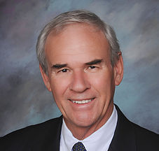
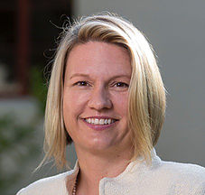
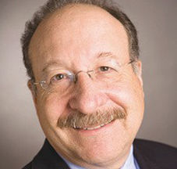
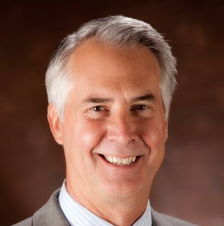
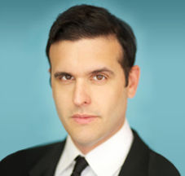
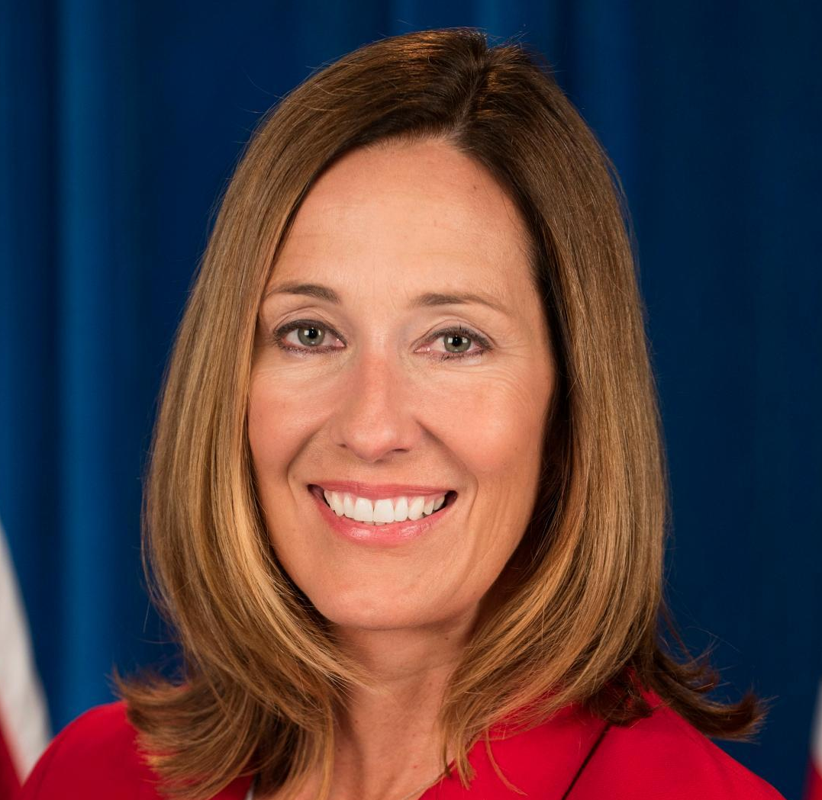
Core Council Members
Stan Mantooth, Chair
Ventura County Superintendent of Schools
Dr. Erika Beck
President, CSU Channel Islands
Henry Dubroff
Editor, Pacific Coast Business Times
Dr. Greg Gillespie
Chancellor, Ventura County Community College District
Eric Harrison
President & CEO, United Way of Ventura County
Jacqui Irwin
California State Assemblymember, 44th District

Slide 4
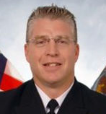
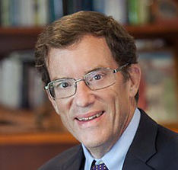
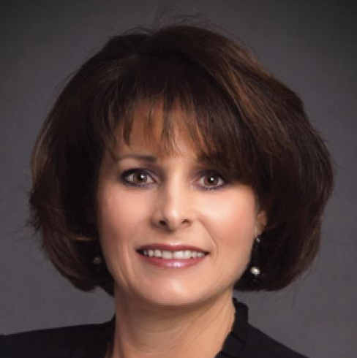
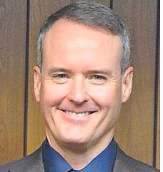
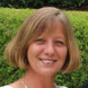
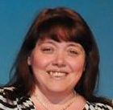
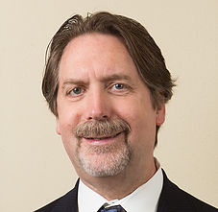
Captain Chris D. Janke
Commanding Officer, Naval Base Ventura County
Dr. Chris Kimball
President, California Lutheran University
Melissa Livingston
Chief Deputy Director, Ventura County Human Services Agency
Michael Powers
County Executive Officer for Ventura County
Petra Puls
Executive Director, First 5 Ventura County
Maria Steck
Treasurer, 12th District PTA
Bruce Stenslie
CEO, Economic Development Cooperative – Ventura County

Slide 5
History
Co-founded as P-16 Council in 2006 by CSUCI’s first president, Dr. Richard Rush and Dr. Charles Weis, County Superintendent of Schools
Changed name to P-20 Council to encompass graduate school in 2015
Facilitated nearly $100 million in grants for local education since its inception

Slide 6
Mission Statement
The Ventura County P-20 Council serves as an engine to advance academic achievement and to eliminate performance gaps thereby promoting college completion, career preparation, and lifelong learning for Ventura County.

Slide 7

Initiatives:
VC STEM
Connects schools and businesses
Provides STEM mentoring
Helps schools enhance STEM programs

Slide 8

Initiatives:
College Promise Programs
Middle and high school students commit to prepare for college-level work
Guaranteed enrollment to Oxnard College or CSUCI

Slide 9
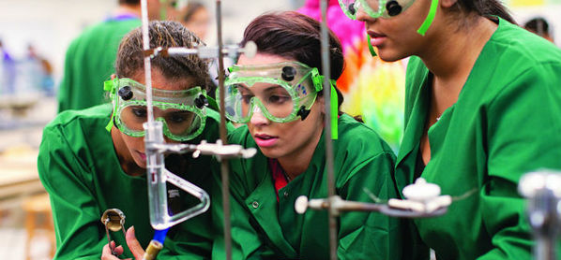
Initiatives:
Business Outreach
Facilitate internships and company tours
Support local workforce development and creation of career pathways

Slide 10
Our Vision
Expand educational pathways that prepare students for careers in Ventura County
Serve as a one-stop-shop for local businesses who want to engage with the education community
Become a central clearinghouse for education information in Ventura County

Slide 11

Get Involved At:
www.vcp20.org

